Slide 1
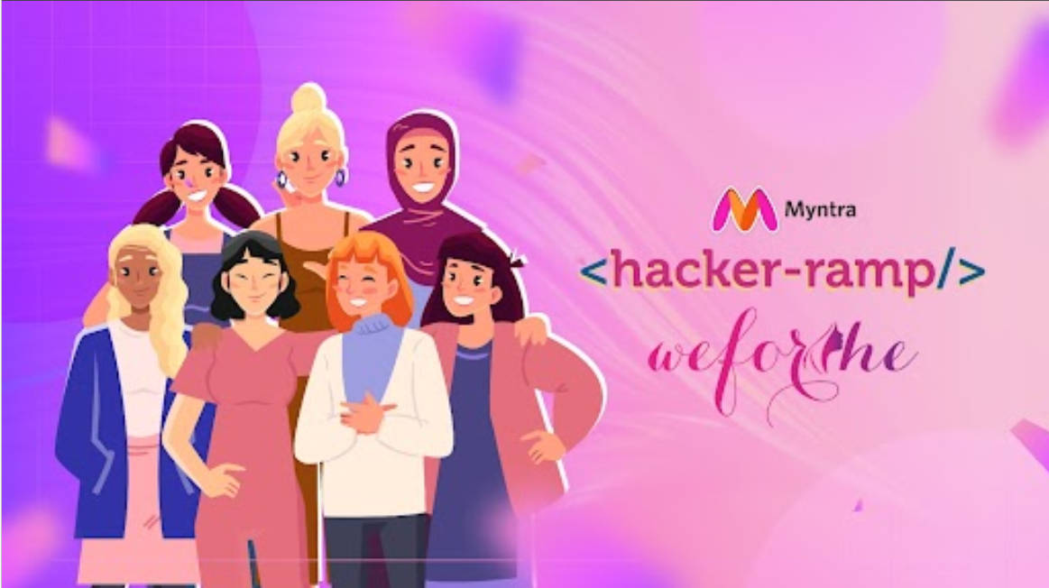

Group Project
Presented by Borcelle Group
Team Name: Enemies_of_Syntax
Team Details:
Gauri Bhosle, Kruti Shah, Manasvi Gupta

Slide 2
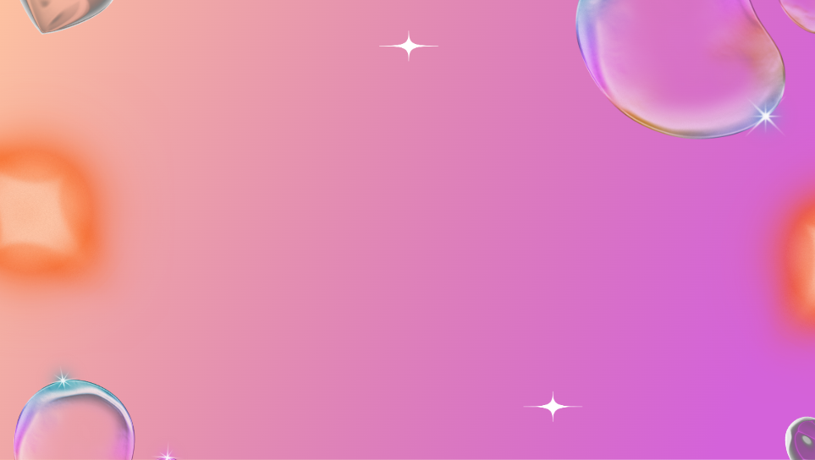
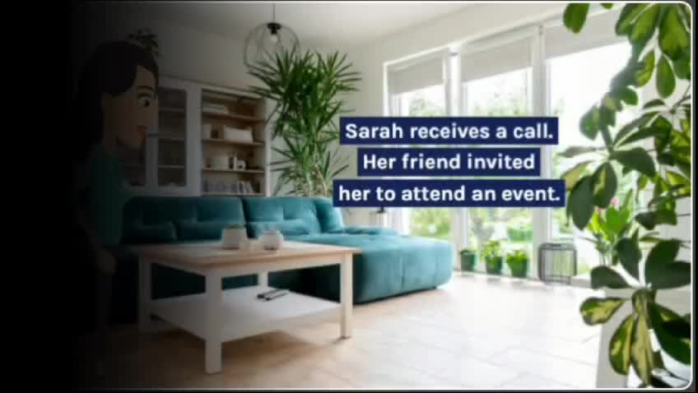
Problem Statement
Use Cases: Trend-Centric Recommendation and Engagement on a shopping platform

Slide 3
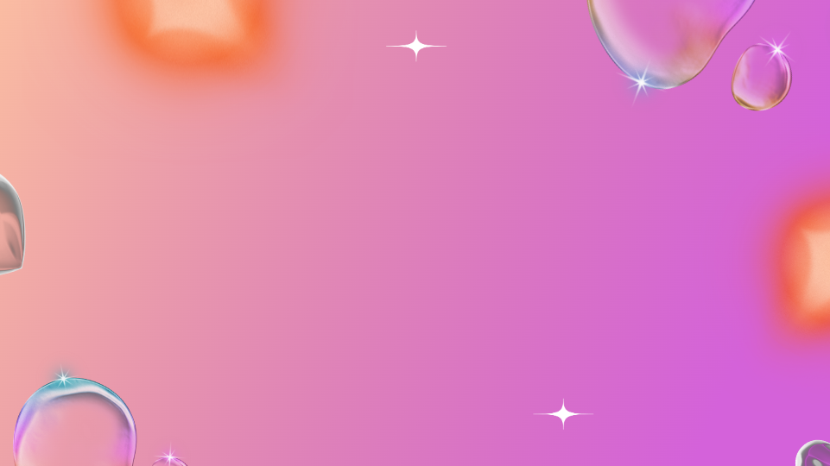
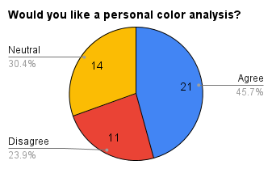
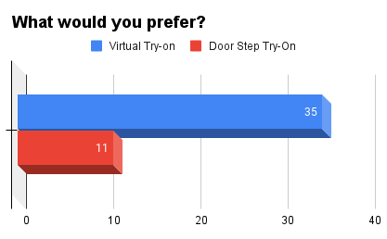
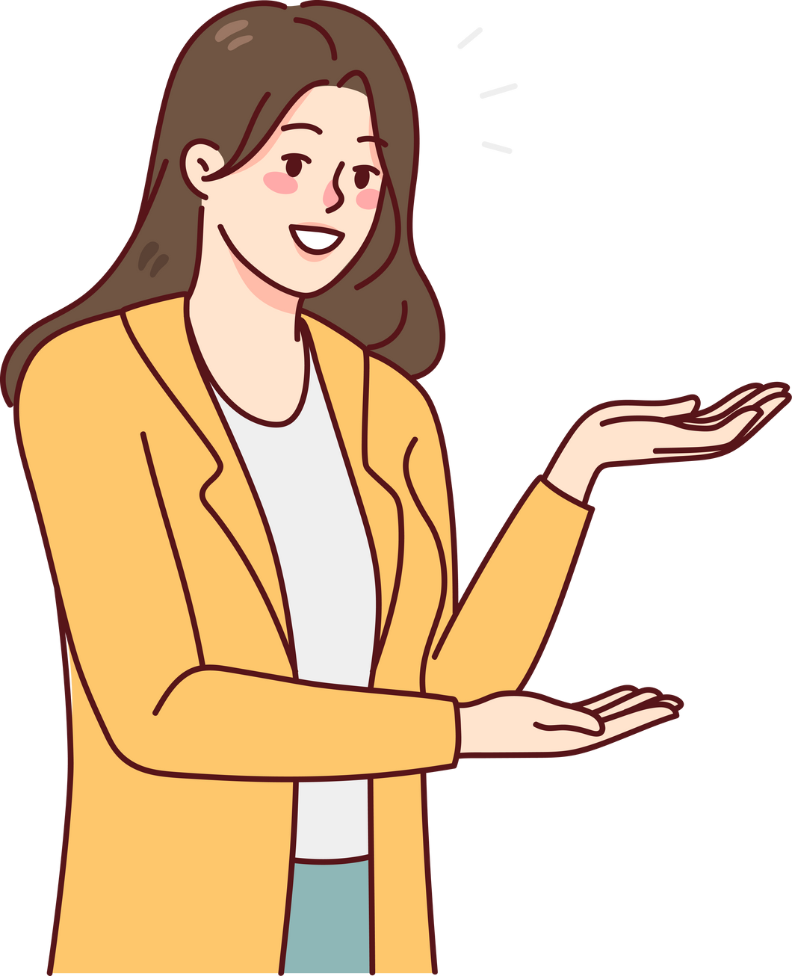
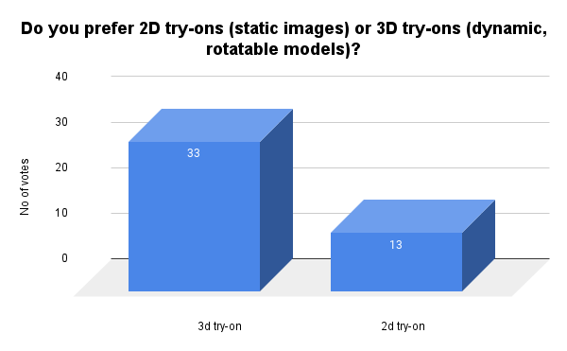

Our Survey Results (Conducted among peers)

Slide 4
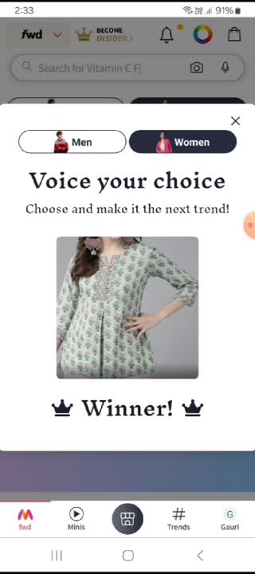
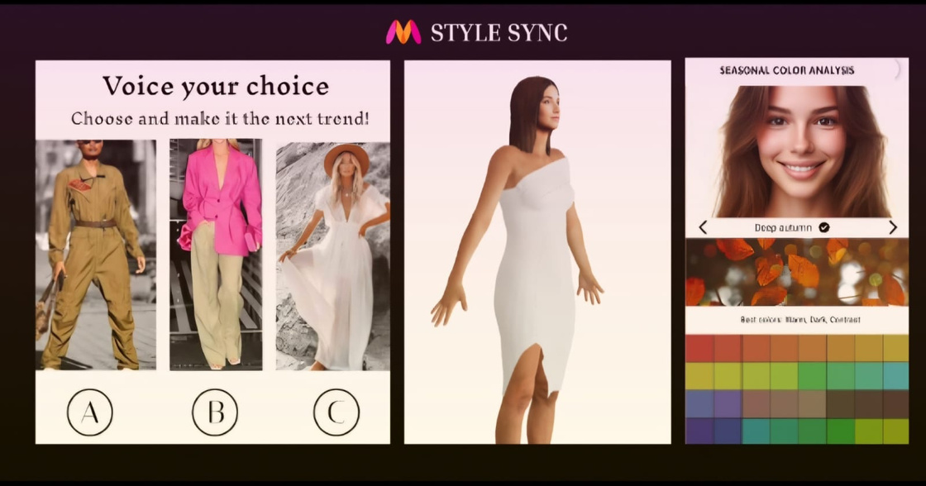
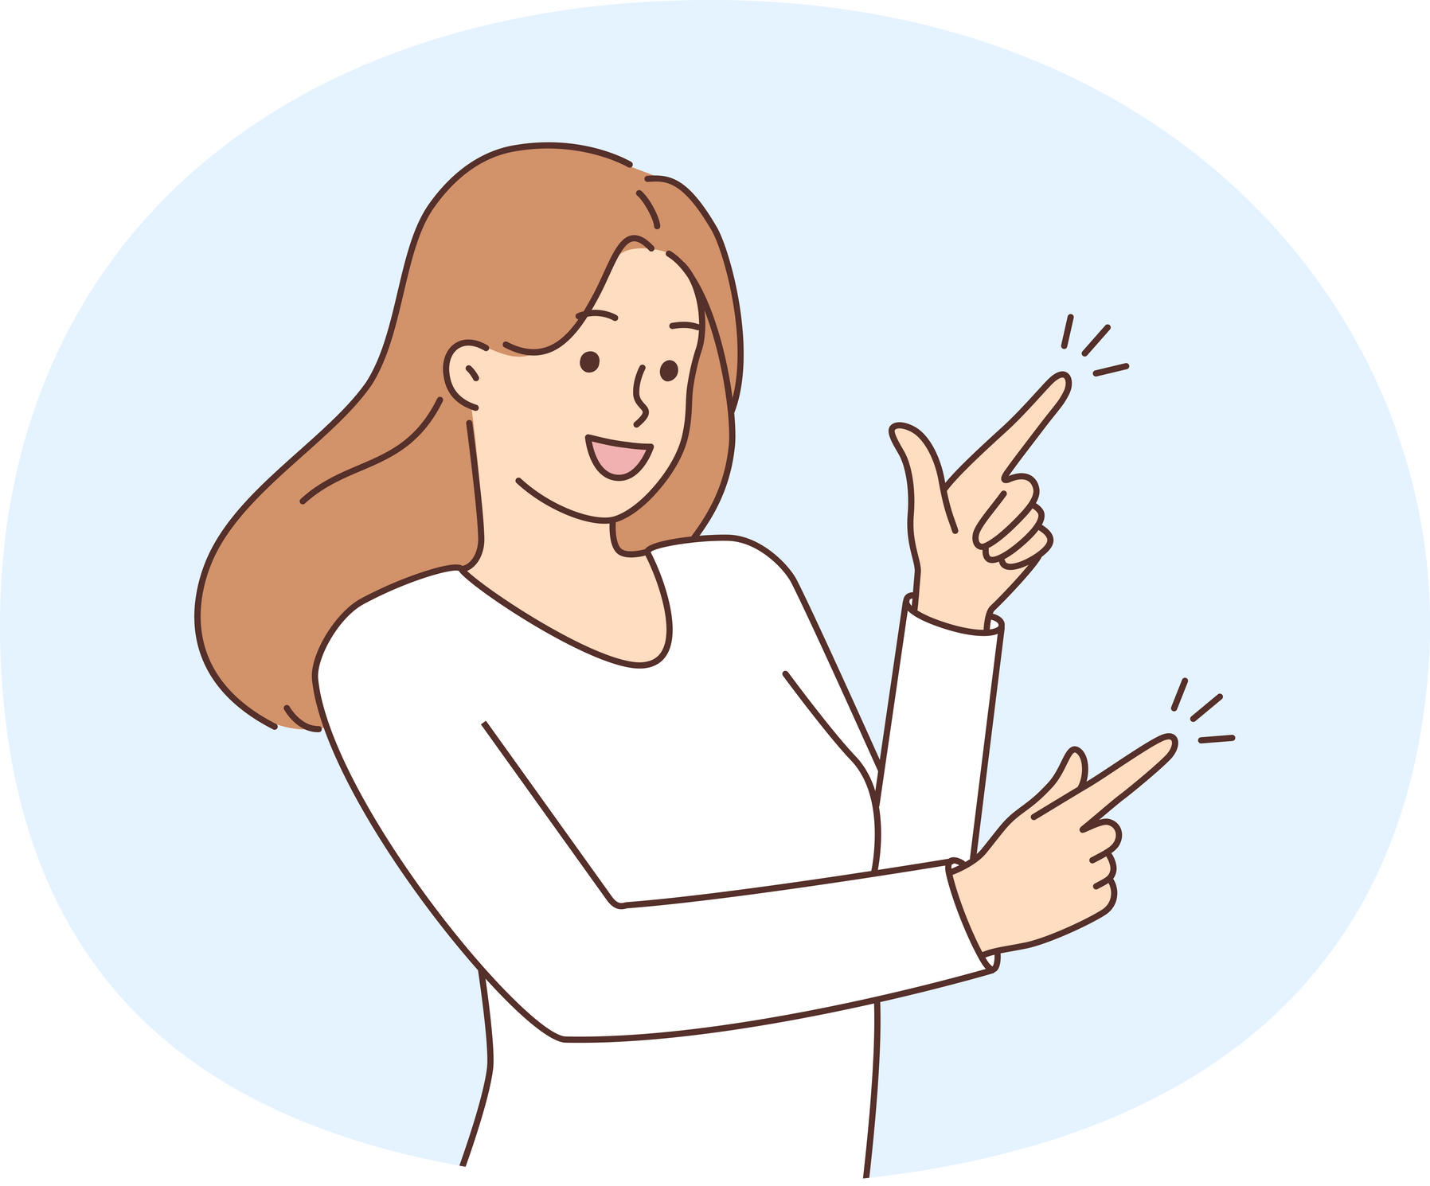
Our Demo Video of solution Style Sync

Slide 5

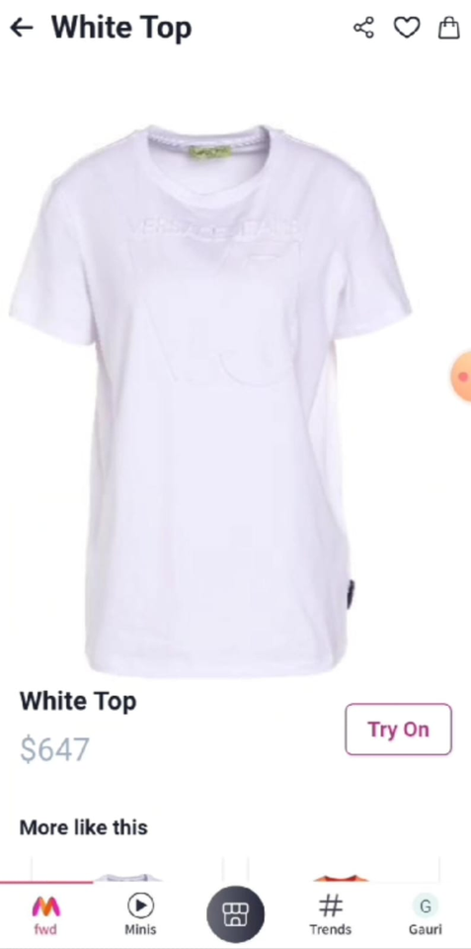
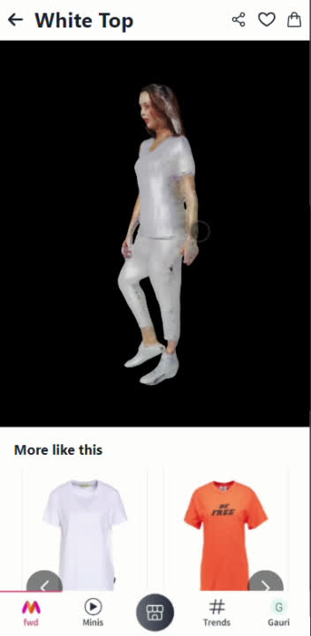

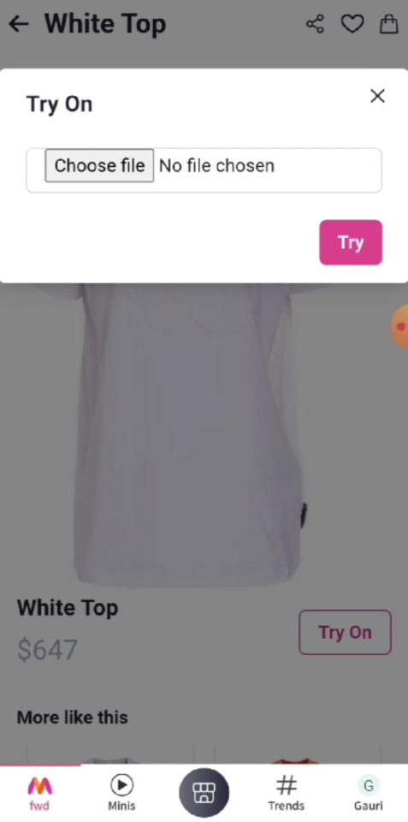
EXPERIENCE A 3D VIRTUAL TRY-ON, VIEWING YOURSELF IN VARIOUS APPAREL FOR A REALISTIC FASHION PREVIEW.
3D Virtual Try On
Upload your image from here
Our advanced DRM Model ensures precise alignment and fit for any body type.
Our MTM Model seamlessly adapts to different poses.
And TFM Model adds texture details for a realistic final image.
Click here for 3D Try On
A PLY file is generated and converted to GLTF, allowing an immersive display of the 3D model.

Slide 6
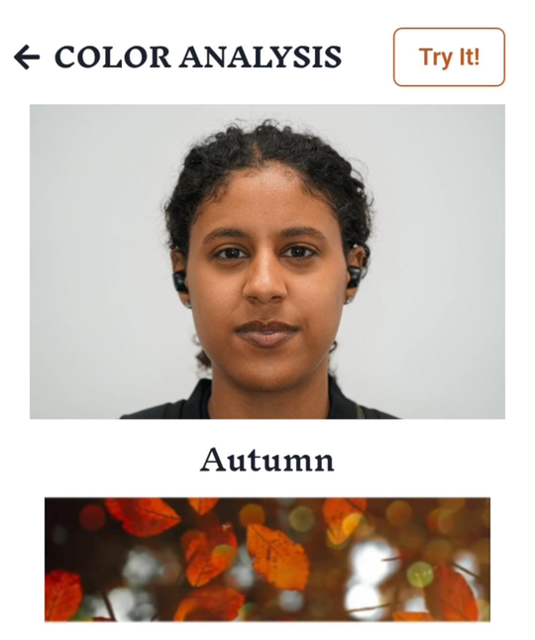

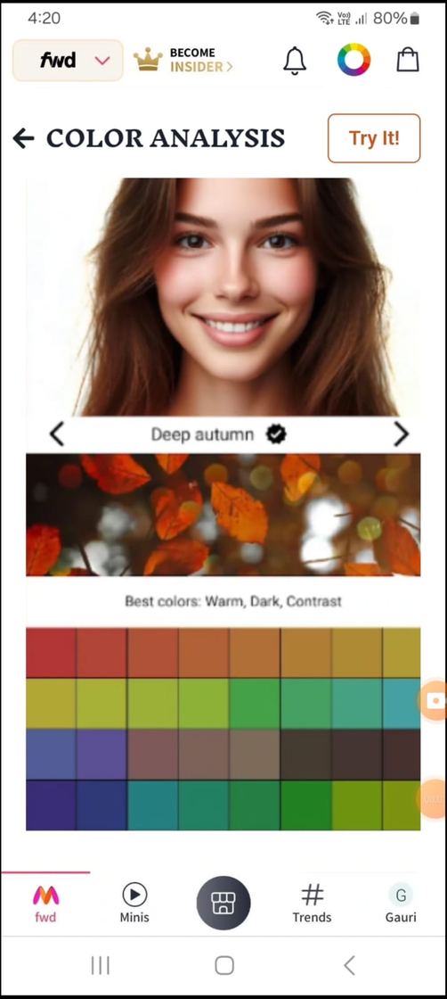


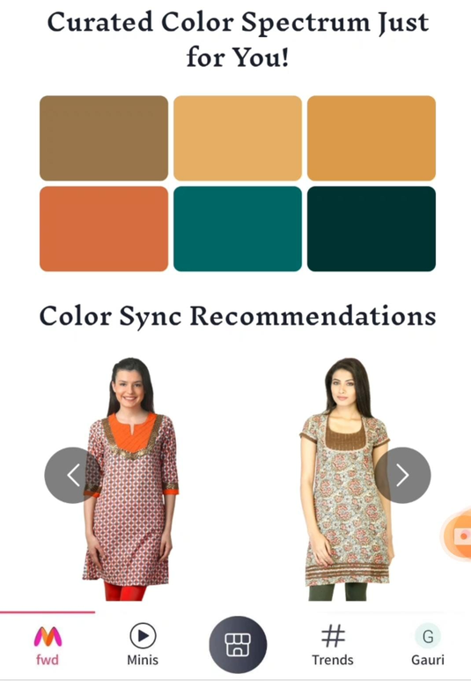

Color Analysis
GET YOUR SKIN TONE ANALYZED TO DISCOVER THE MOST FLATTERING CLOTHING COLORS, PROVIDING YOU WITH PERSONALIZED FASHION ADVICE.
Upload your image from here
Our advanced algorithms such as MTCNN, Dlib, and OpenCV, meticulously analyzes the image
From this, the Google's Gemini Model, identifies your ideal seasonal palette
Then, our ResNet Model delivers personalized clothing and accessories

Slide 7
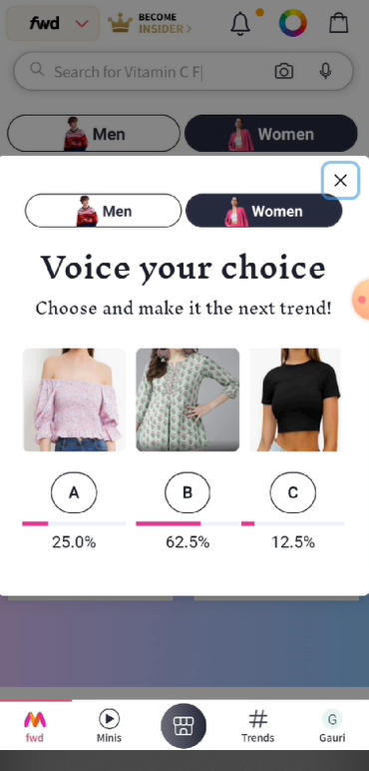
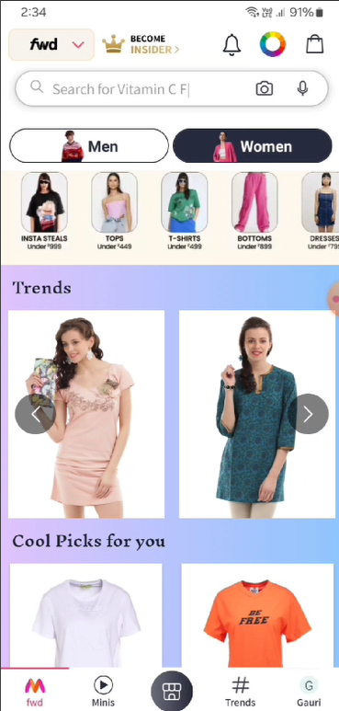
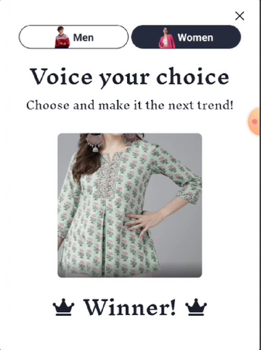

Voice Your Choice
YOUR VOTES SHAPE THE STYLE - WATCH FASHION EVOLVE IN REAL-TIME!
Similar items are recommended using the K Nearest Neighbors algorithm based on the extracted features.
Features are extracted from the winning image using the ResNet 50 model.
Highest votes wins!
Vote for your favorites to set the next fashion trend!

Slide 8
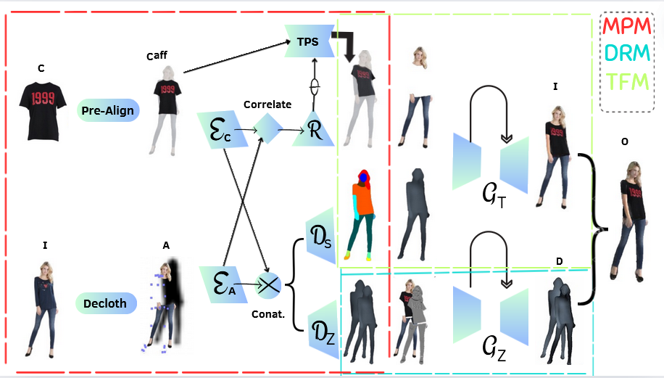
Architecture Diagram of 3D Try On
Figure Annotations
p
C:Clothing item
I:Image of person
A:cloth-agnostic person
Di: Initial Depth
X:Shadow
Ip: Preserved image
W: Warped Clothing
S:Segmentation Mask
D:Final Depth
O:3d model
TPS:Thin Plate Spline (TPS) transformation
Ec: feature map of existing clothing
Ea : feature map of adapted clothing
Dz:Depth Decoder
Ds:Segmentation decoder
Gt:Target generator
Gz:UNet-like generator
W
I
t
S
X
D
i
R
MPM: Monocular Prediction Module DRM: Depth Refinement Module
TFM: Texture Fusion Module

Slide 9
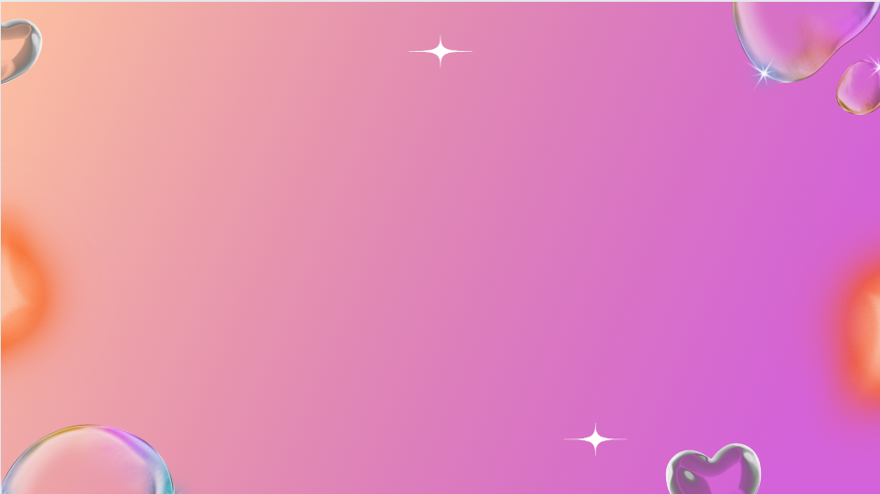




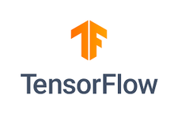





Business Advantage
Tech Stacks
Enhanced User Engagement and Loyalty: By providing a interactive platform where users can influence and vote on fashion trends, the app fosters a sense of community and engagement.
Reduced Returns and Improved Conversion Rates: Virtual try-ons enable users to visualize how clothing will look on them before purchasing which reduces uncertainty, leading to fewer returns, higher conversion rates, and increased consumer confidence.
Trend-Centric Recommendations: Real-time analysis of user input provides valuable insights for trend forecasting and inventory management, helping brands stay ahead of trends and optimize inventory.
Capitalize on Global Trends: Integrating personal color analysis can capitalize on global trends, enhance personalization, and attract trend-conscious consumers.
React.js
Hugging Face
Flask
TensorFlow
Selenium
Python
GeminiAI
SQLite

Slide 10
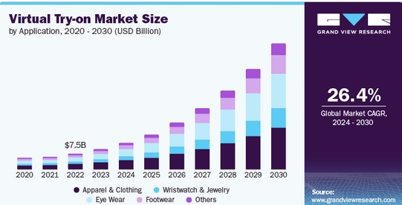
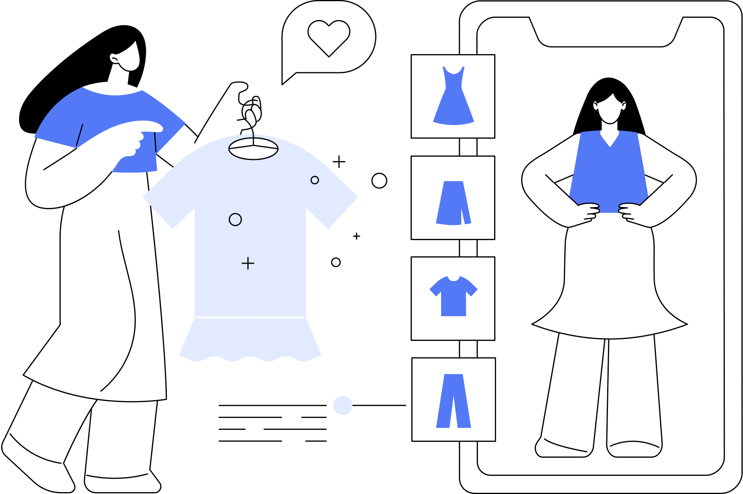
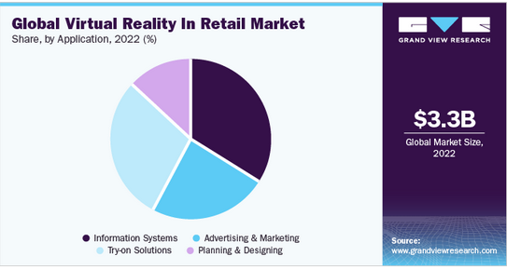
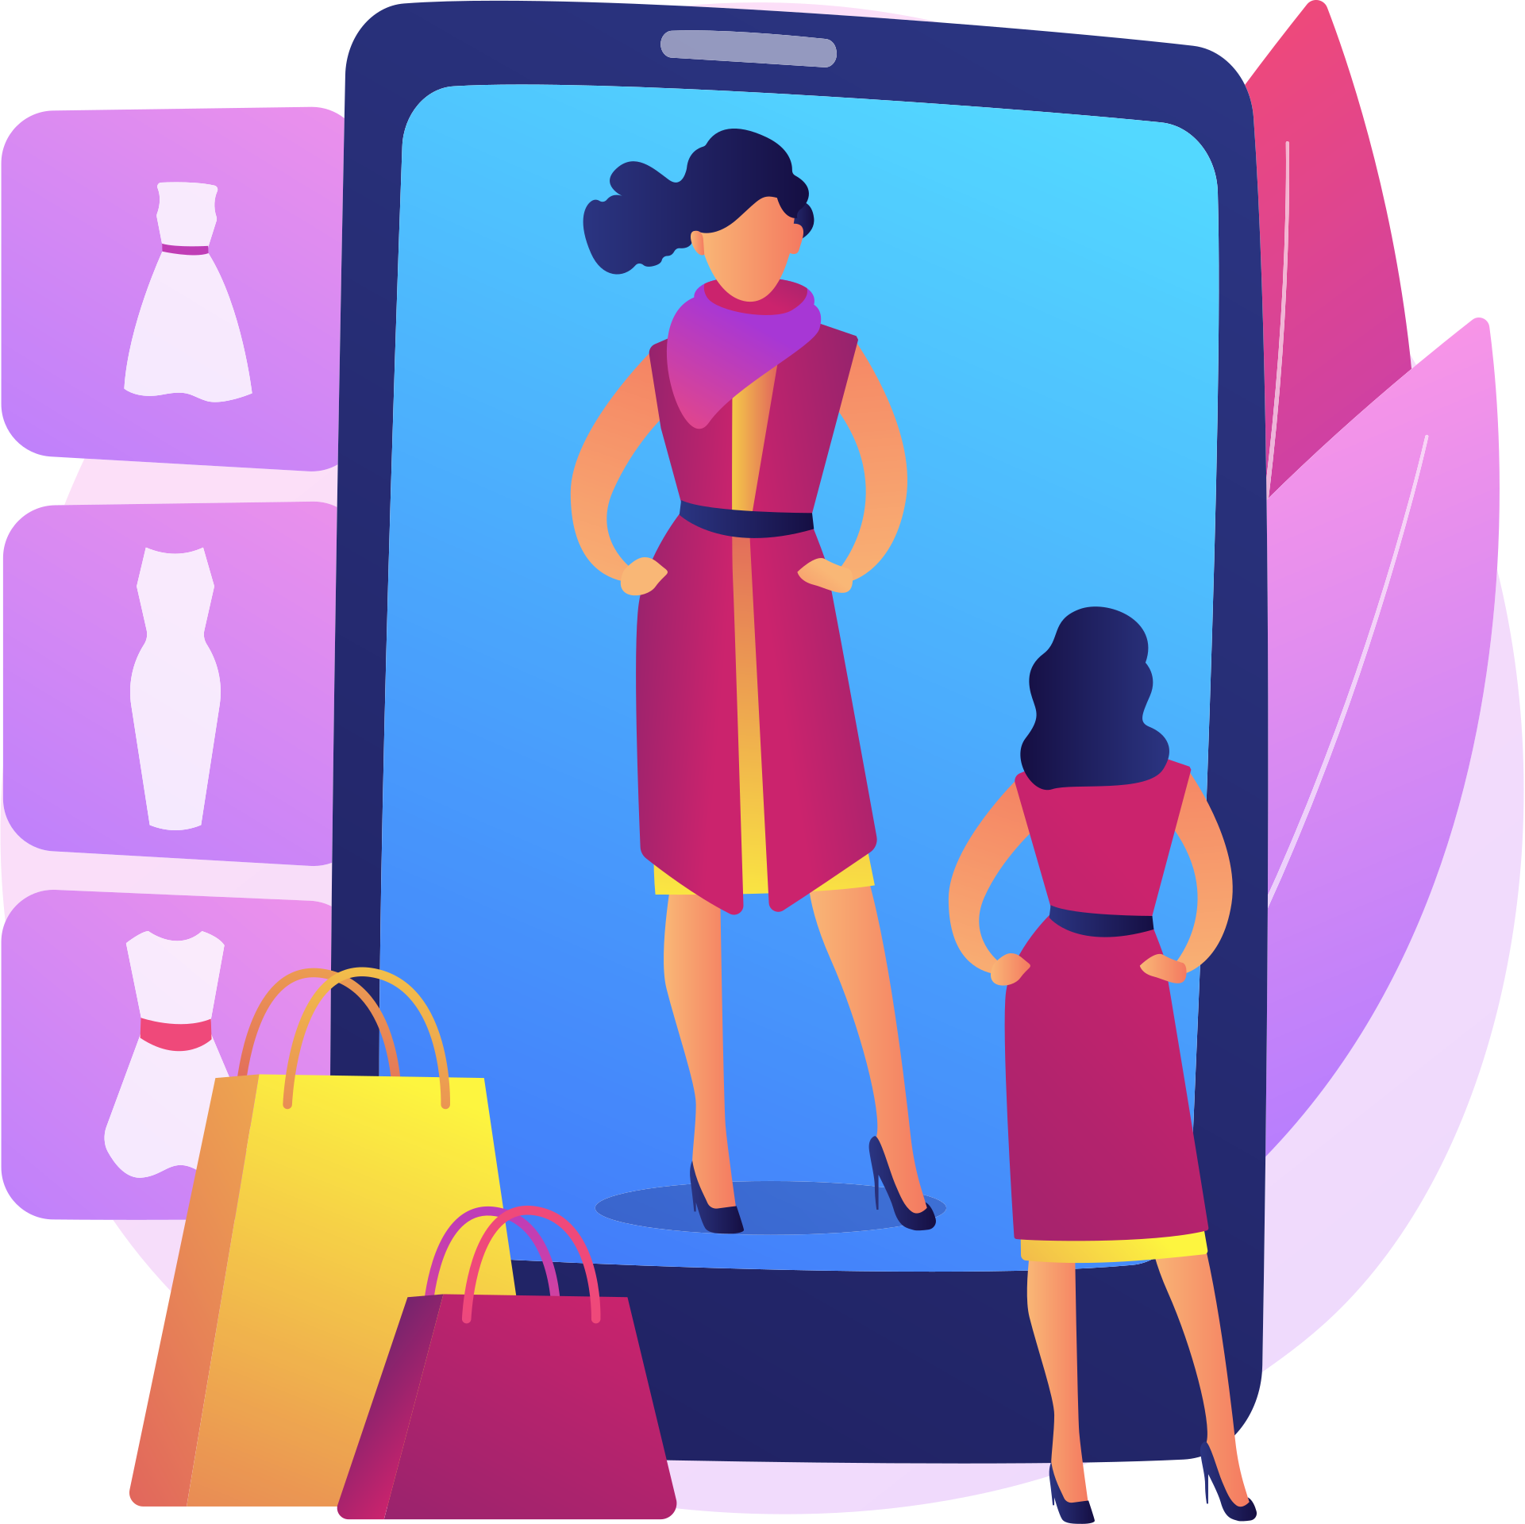

Virtual Try-On Statistics

Slide 11
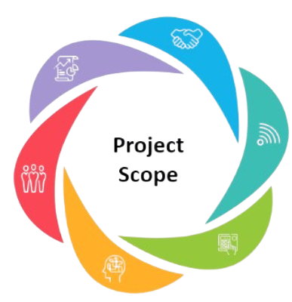
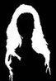


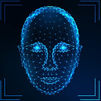
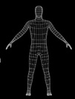
Enhancements to the Current System
Hair Segmentation: Enhance precision in detecting hair color for better personalised color analysis.
Real-Time Global Trends Scraping: Implement real-time scraping of global fashion trends to keep recommendations current and relevant.
Color Bot GPT: Integrate a GPT-powered color bot for more accurate and personalized color suggestions.
Potential
Upgrades
Fast Backend Processing: Optimize backend processing to reduce latency and enhance user experience.
Robust Facial Feature Detection: Ensure accurate detection of all facial features under variable lighting conditions.
Improved 3D Model Realism: Implement accurate back mirroring and fill mesh holes for a more realistic appearance.

Slide 12


